Slide 1

CAREER COUNSELLING
NAVIGATING YOUR PATH TO SUCCESS
VIRAM J SHAH
22002170110172
ROLL NO : 105
BATCH A3

Slide 2

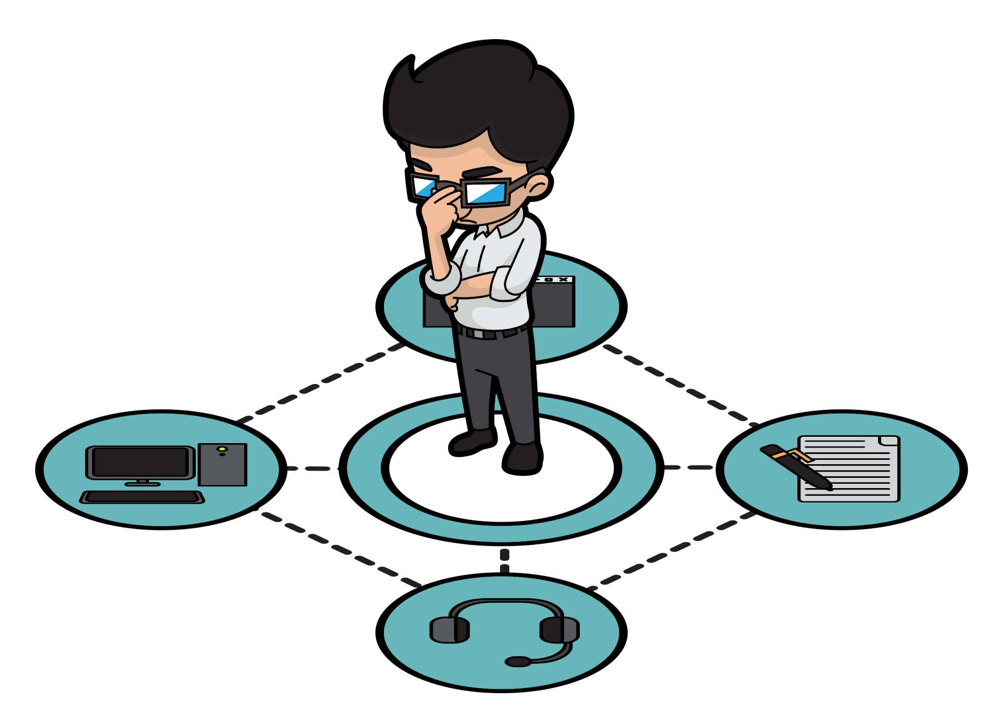
Career Counselling Project Using Machine Learning
In today's dynamic job market, individuals face numerous career choices, making it challenging to identify the most suitable path.
The Career Counselling Project utilizes Machine Learning Techniques to provide personalized career guidance based on individual skills and preferences.

Slide 3

Data Preprocessing & Model Training
Data preprocessing and model training are crucial steps in developing a machine learning solution for career counselling.
Data Preprocessing:
Involves preparing the dataset by splitting it into input features and output labels.
Utilizes techniques such as train-test split and label encoding to ensure data readiness for model training.
Model Training:
Selects the RandomForestClassifier algorithm for its robustness and versatility.
Trains the model on the preprocessed dataset to learn patterns and relationships between input features and output labels.

Slide 4

Model Performance Analysis & Conclusion
Model Performance Analysis:
The project achieved an accuracy of 70% in assigning roles based on input data.
Conclusion:
Summarize the model's effectiveness in assigning roles based on input data.
Reflect on the detailed descriptions provided for given role.

Slide 5
Thank you !!

